Slide 1
CSX4109 / ITX4109
ANDROID APPLICATION DEVELOPMENT

Slide 2
RECAP
Render a text field at the center of the screen. It has a label “Student Code”. The text field only allows the user to input numbers for not more than 7 characters. If the input is not a number, the text does not show the input text. The input in the text field must be retained even if the device’s orientation is changed.

Slide 3
What triggers UI components to update?

Slide 4
STATE

Slide 5
OBSERVABLE
import kotlin.properties.Delegates.observable
var counter by observable(-1) { _, oldValue, newValue ->
println("Old: $oldValue --> New: $newValue")
}
fun main() {
for (i in 0..3) { counter = i }
}

Slide 6
STATEFUL VS. STATELESS
Stateful = Manage State by Itself
Stateless = No State in the Function

Slide 7
STATEFUL
@Composable
fun StateDemo1() {
val currentText = remember{ mutableStateOf(“”) } Text( text = currentText.value )
...
}

Slide 8
STATEFUL (Cont.)
@Composable
fun StateDemo2() {
val currentText by remember{ mutableStateOf(“”) } Text( text = currentText )
...
}

Slide 9
STATELESS
@Composable
fun SimpleText1() {
Text(“Hello Android”)
}
@Composable
fun SimpleText1(text: State<String>) {
Text(text.value)
}

Slide 10
KEYS OF STATELESS
Fast - No Heavy Load
Free of Side-Effect - Never Modify Global Properties
Idempotent - No remember

Slide 11
STATELESS DEMO
@Composable
fun TextFieldDemo(currentText: String, onTextChanged: (String) -> Unit) {
TextField(currentText, onValueChanged = onTextChanged)
}

Slide 12
EXCERCISE 1
Create an application to show a greeting message followed by the student code entered by the user in a text field. The text field must have the same functionality and properties like the Recap

Slide 13
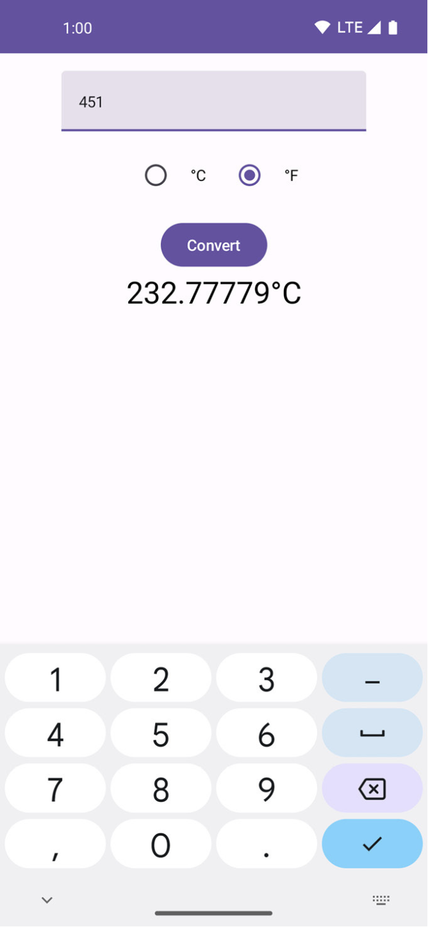
EXCERCISE 2
Create an application to convert the temperature between Celsius and Fahrenheit in the stateless mechanism
Calculation
Celsius = ( t x 1.8 ) + 32
Fahrenheit = ( t - 32 ) / 18

Slide 14
THANK YOU

